Slide 1
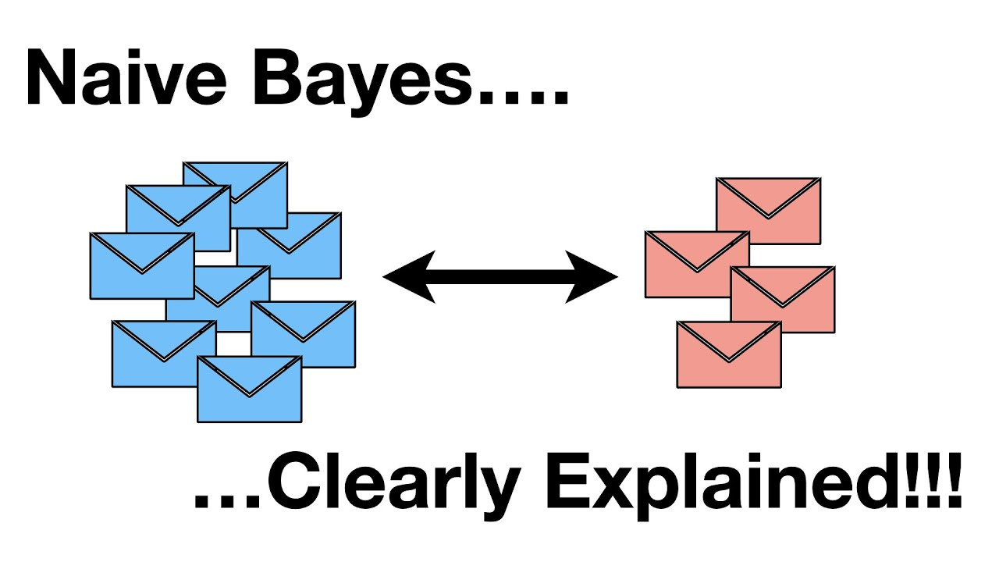

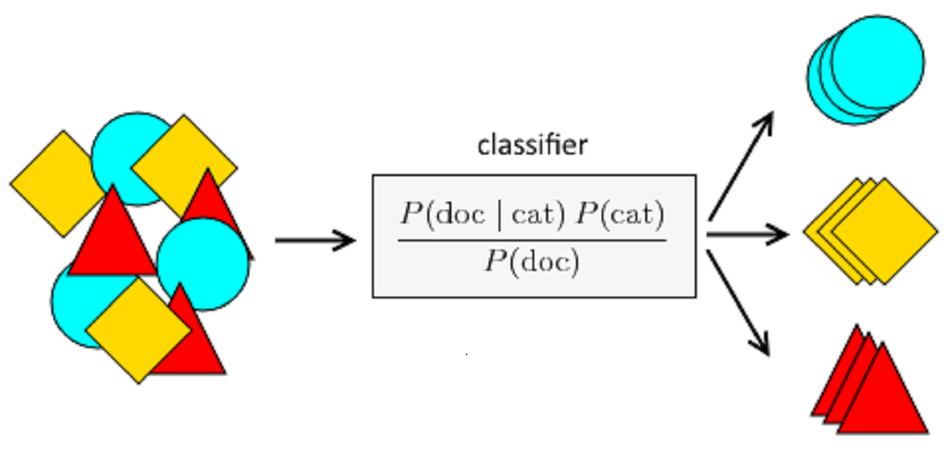
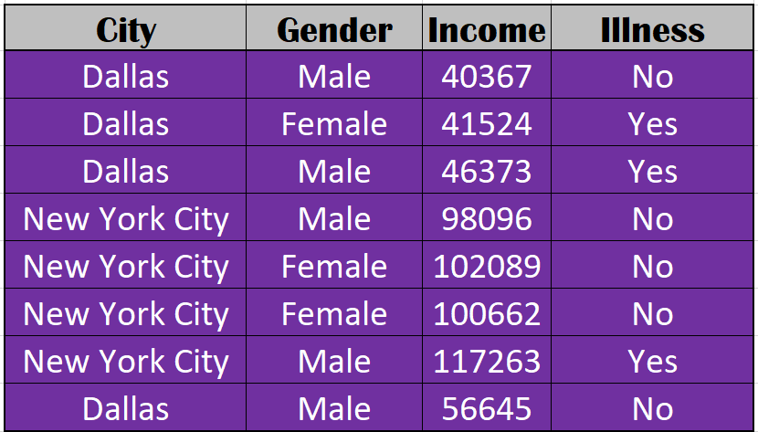
Naive Bayes
Sargis Abrahamyan, Justin Bartell, Raymond Sepulveda, Daniel Brickman

Slide 2
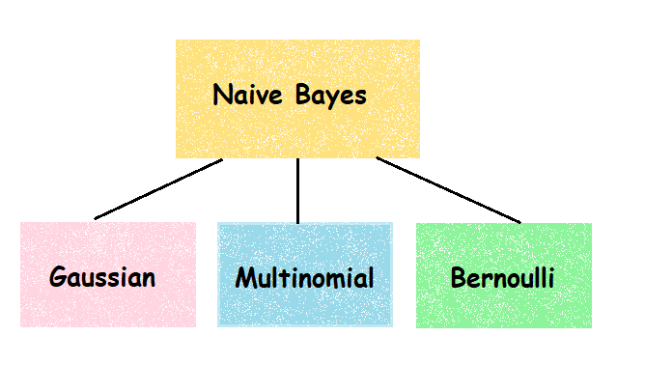
5 Types of Naïve Bayes
Gaussian: for continuous, normal variables
Multinomial: for discrete variables (counts)
Complement: for discrete variables (counts) -- better with imbalanced sets
Bernoulli: for binary variables
Categorical: for categorical variables (requires encoding to numeric)

Slide 3

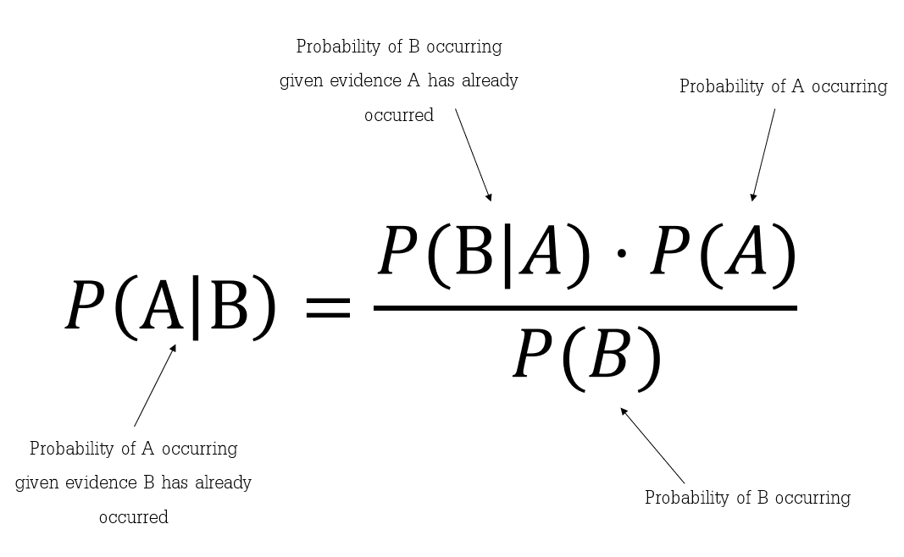

Equations

Slide 4
Math ☺
Cars | Red | Blue
2 Seats | 15 | 20
4 Seats | 30 | 35
P(4 Seats | Red) = P(Red | 4 Seats) * P(4 Seats) / P(Red)
P(Red) = (15+30) / 100 = 0.45
P(4 Seats) = (30+35) / 100 = 0.65
P(Red | 4 Seats) = 30 / (30+35) = 6/13
=((6/13)*0.65) / 0.45 = 2/3
P(4 Seats | Red) = 30/45=2/3

Slide 5
Math (but now with more columns) ☺
Amount of rows with outcome y divided by number of rows (same as P(A) before)
Probability of the outcome/class being "y" given the other columns.
The probability of a specific column/attribute given the outcome/class is y (calculating this probability differs based on the type of Naïve Bayes)
Because we are assuming that all variables are independent, multiply all the probabilities together
When used for predicting, it will compute this probability for every possible outcome/class. It will predict whichever outcome/class has the highest probability
This term is usually ignored because it will be the same for every possible outcome/class

Slide 6
Index | Color | Cylinders | Seats
1 | Red | 6 | 2
2 | Red | 4 | 2
3 | Blue | 6 | 2
4 | Red | 6 | 4
5 | Red | 6 | 4
... | ... | ... | ...
10 | Blue | 6 | 4
Cars | Red | Blue
2 Seats | 2 | 2
4 Seats | 3 | 3
Cars | Red | Blue
4Cylinder | 1 | 3
6Cylinder | 4 | 2
Cars | 4Cylinder | 6Cylinder
2 Seats | 3 | 1
4 Seats | 1 | 5
P(4 Seats | Red, 6Cylinder)
=P(4 Seats) * P(Red| 4 Seats) * P(6Cylinder | 4 Seats) / P(Red, 6Cylinder)
P(4 Seats) = 3/5
P(Red | 4 Seats) = 1/2
P(6Cylinder | 4 Seats) = 5/6
P(Red, 6Cyliner) = 4/10=2/5
=(3/5 * 1/2 * 5/6) / 0.4 = (36/175) / 0.4 =5/8=0.625

Slide 7
Advantages Disadvantages
Works quickly and can save a lot of time
Does not require as much training data
Suitable for solving multi-class prediction problems
Highly scalable with the number of predictors and data points
Not sensitive to irrelevant features
IF data is independent, then it performs better than other models and requires less training
Better suited for categorical input variables than numerical variables compared to logistic regression.
Assumes that all predictors are independent. Logistic regression does not require this assumption to be met
Faces the ‘zero-frequency problem’
Assigns zero probability to a categorical variable whose category in the test data set wasn’t available in the training dataset.
Its estimations can be wrong in some cases, so you shouldn’t take its probability outputs very seriously.
When N -> ∞, Logistic Regression outperforms Naïve Bayes

Slide 8
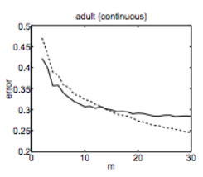
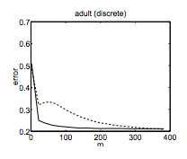
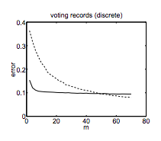
Naïve Bayes vs. Logistic Regression
- Naïve Bayes -- Logistic Regression
m = # of training examples error = error rate

Slide 9
Processing / Tuning
Remove nulls
Check/Decide to work with outliers
No need to normalize data, unless you need the class probabilities
Categorical vs Numerical
Need to convert to a single data type
Categorical -> Numeric: Dummy variables
Numeric -> Categorical: Grouping
or separate datatypes and conduct bayes analyses separately

Slide 10
Processing / Tuning
Make sure α is set to something (Multinomial, Complement, or Categorical)
Helps with 'zero-frequency' problem by preventing a 0 probability for elements not seen during training
Larger α value will lead to unknowns having a greater impact on final probability
α defaults to 1

Slide 11
Appendix I: Examples
Gaussian Naive Bayes Classifier Algorithm
Multinomial Naive Bayes Classifier Algorithm

Slide 12
Appendix II: Sources
Naive Bayes scikit-learn Module
Naive Bayes Advantages, Disadvantages, and Applications in 2022
Javapoint - Naive Bayes Classifier Algorithm
Naive Bayes Classification Using Scikit-learn In Python
Naive Bayes - Clearly Explained Video
Learn Naive Bayes - Codes in Python and R

Slide 13
Appendix III: Methods for Handling Categorical and Numerical Data
https://stackoverflow.com/questions/14254203/mixing-categorial-and-continuous-data-in-naive-bayes-classifier-using-scikit-lea
https://medium.com/analytics-vidhya/naive-bayes-for-mixed-typed-data-in-scikit-learn-fb6843e241f0
If you decide to go down this route, look at the .class_prior_ attribute

